Slide 1
VPC (Virtual Private Cloud)
It is a virtual network that closely resembles a traditional networking that you operate in your own datacentre with the benefits of using the scalable infrastructure of AWS.
OR
It is a virtual network or datacentre inside AWS for one client.
It is logically isolated from other virtual n/w in the AWS cloud.
Max. 5 VPC can be created in one region & 200 subnets in one VPC.
We can allocate max. 5 elastic IP
Once we created VPC ……..DHCP,NACL & security group is created automatically.
A VPC is confined to an AWS region & does not extend between regions.
We can’t change VPC CIDR size once it is created
If you need a different CIDR size, need to create another VPC
Different subnets within VPC can’t overlap
VPC Types:-
1.Default VPC
Created in each AWS region when an AWS account is created
Has default CIDR,Security group,NACL.Route table setting
Has an internet gateway by default
2.Custom VPC
Created by admin and has default CIDR,Security group,NACL,Route table setting
Does not have internet gateway by default

Slide 2
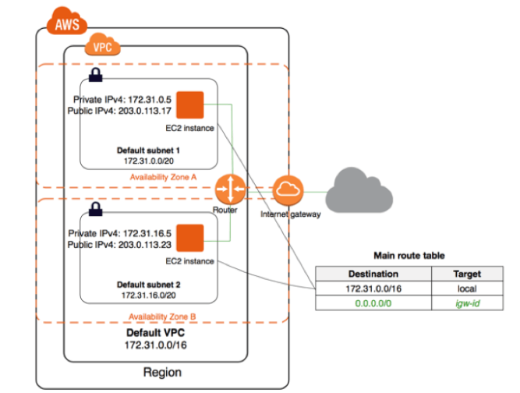
VPC Architecture

Slide 3
VPC Component
> VPC
> Subnet
> Route Table
> Internet Gateway
> Security Group
> Network ACL
> VPC Peering
SUBNET
Public Subnet :- > If a subnet traffic is routed to an internet gateway ,that subnet is known as public subnet.
>If you want your instances in a public subnet to communicate with the internet over IPv4 it
must have a public IP address or an elastic IP address
Private Subnet :->If a subnet traffic does not have route to an internet gateway,that subnet is known as private subnet.
>When you create a VPC you must specify IPv4 CIDR.The allowed block size is between /16 to /28
>The first four and last IP address of subnet can not be assigned.
Ex. 10.0.0.0/24
10.0.0.0 - N/W add
10.0.0.1 - Reserved by AWS for VPC Router
10.0.0.2 - Reserved by AWS for DNS Server
10.0.0.3 - Reserved for future use
10.0.0.255 - B/C address
(only 251 IP available)
NOTE :- AWS do not support broadcast in a VPC but reserve the address.

Slide 4
Route Table
> It connect two different AZ & also connect VPC to internet gateway.
> You can have upto 200 route table per VPC.
> You can have upto 50 route entries per route table.
> Each subnet must be associated with only one route table
> If you don’t specify a subnet to route table association, that subnet will be associated with the default VPC route table.
> You can also edit the main route table if needed but cannot be deleted.
> If you declare a custom route table as main route table then former main route table can be deleted.
>You can associate multiple subnets with same route table.
Internet Gateway
> It is a virtual router that connect VPC to the internet.
> Default VPC is already attached with internet g/w.
> If you create a new VPC then you must attach internet g/w in order to access the internet.
> Ensure that subnet’s route table points to the internet gateway.
> It perform NAT between private & public IP address.
> It support both IPv4 & IPv6.

Slide 5
NAT Gateways
> It enable instances in private subnet to connect to the internet or other AWS instances but prevent the internet from initiating a connection with those instances.
> You are charged for creating and using NAT g/w as well as for data processing hourly.
> To create a NAT g/w you must specify the public subnet in which it should reside.
> You must also specify an elastic IP address to associate with NAT g/w when you create it.
> No need to assign public IP address to your private instances.
> After creating NAT g/w, you must update the route table associated with one or more of your private subnets to point internet bound traffic to the NAT g/w i.e. it enable instances in private subnet to access internet.
> Deleting the NAT g/w, it disassociate its elastic ip address but does not release the address from your account.
Security Group
> It is a firewall that work at ENI level
> Upto 5 security group per EC2 instances interface can be applied.
> Can only have permit rule
> It is stateful

Slide 6
NAT ACL
It is a function performed on implied router.
It is an optional layer of security for VPC that act as firewall for controlling traffic to or from subnet.
Your VPC automatically comes with a default NACL & it allow all inbound/outbound traffic
You can create custom NACL and associate with a subnet.
By default custom NACL deny all inbound/outbound traffic until you add rules.
Each subnet must be associated with a NACL otherwise associated with default NACL.
You can associate a NACL with multiple subnet but a subnet can be associated with only one NACL
When you associate a NACL with a subnet the previous association is removed.
NACL consist numbered list of rules that is evaluated in order starting with the lowest numbered rules.
(highest no. for rule is 32766)
It function at subnet level
NACL is stateless
Permit and deny rules are available in NACL
Security Group NACL
>Operate at instance level >Operate at subnet level
>Supports allow rule only >Support both permit and deny rule
>It is stateful >It is stateless
>Apply to instances only >Apply to all instances in the subnet

Slide 7
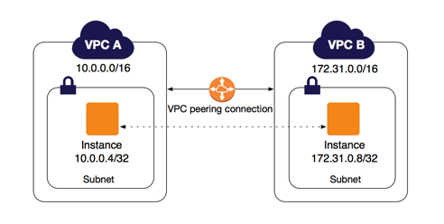
VPC Peering
It is a networking connection between two VPC that enable to route traffic between them using private IP address.
You can create VPC peering connection between your own VPC or with a VPC in another AWS account or VPC in different region.
There are some limitations on VPC peering connections. As a default, you can add 50 VPC peering connections to a single VPC. This number is adjustable however and you can scale this up to 125 connections per VPC

Slide 8
Primary step to configure a VPC :-
1. Create VPC
2. Create Subnet
3. Create Internet Gateway ant Attach to VPC
4. Create Route Table & Associate Subnet
VPC Lab
1. VPC with a single Public Subnet
2. VPC with Public and Private Subnets(using NAT gateway)
3. VPC Peering between two different VPC within same region
4. VPC Peering between two VPC in different region
5. AWS NACL inside VPC
6. VPN connection in AWS

Slide 9
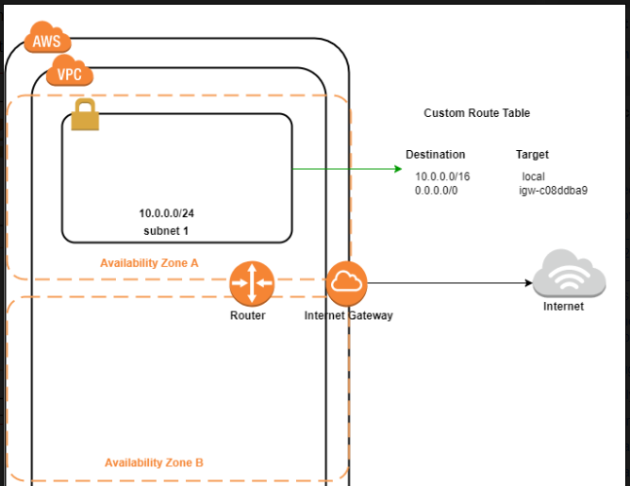

1. VPC with a single Public
Subnet
Create VPC-01 with CIDR - 10.0.0.0/16
Create Subnet-01 (10.0.0.0/24)
Create Internet Gateway-IGW-01
Attach IGW-01 to VPC-01
Create Route Table – Route-01
Select Route-01, Edit Route & Add route
0.0.0.0/0, attach with IGW-01
Select Route-01, Subnet Association and
select 10.0.0.0/24 & Save
Now, launch EC2 in VPC-01 & ping 8.8.8.8

Slide 10
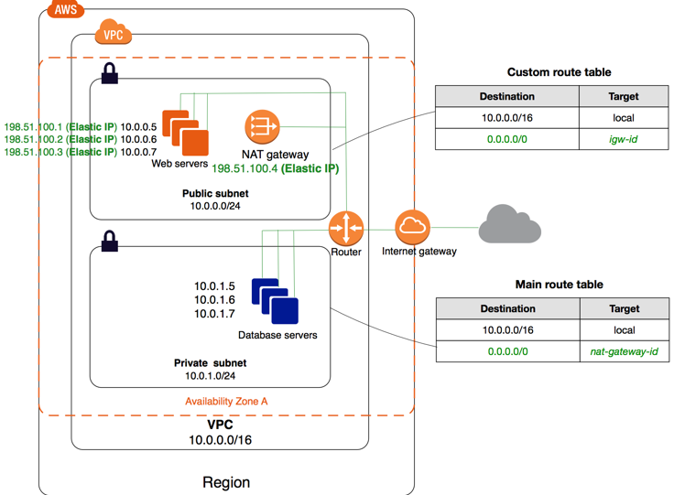
2. VPC with Public and Private Subnets (using NAT gateway)
Create VPC-NAT with CIDR - 10.0.0.0/16
Create two Subnet
Public Subnet - 10.0.0.0/24
Private Subnet - 10.0.1.0/24
Create Internet Gateway-IGW-NAT
Attach IGW-NAT to VPC-NAT
Go to Route Table & Create Two RT
1. Public Route & Add route 0.0.0.0/0 with IGW-NAT
and associate public subnet 10.0.0.0/24
2. Private Route
only associate private subnet 10.0.1.0/24
Now launch one EC2 in both subnet

Slide 11
Go to VPC & create NAT gateway (NAT-01), select public subnet & allocate elastic IP
Go to route table, select private subnet, edit route and add Route 0.0.0.0/0 with NAT Gateway-NAT-01
Now access public EC2 and open Remote Desktop
Enter private ip address of private EC2
- Username – Administrator
- Password – Decrypt from Private EC2, copy & paste
Now try to ping 8.8.8.8 from private EC2
-----------------------------------------------------------------------------------------------------------------------------
For Linux
Access Public EC2 & give admin rights
Run command #vi abc.pem
Open your key in notepad, copy & paste
Press Esc button, then :wq & enter
Run -- chmod 700 pk.pem
ssh -i pk.pem ec2-user@10.0.1.66

Slide 12
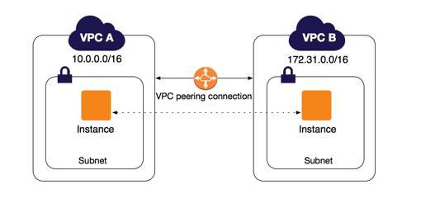
3. VPC Peering between two different VPC within same region
Create VPC-01 with CIDR - 10.0.0.0/16
Create Subnet-01 (10.0.0.0/24)
Create Internet Gateway-IGW-01
Attach IGW-01 to VPC-01
Create Route Table – Route-01
Select Route-01, Edit Route & Add route
0.0.0.0/0, attach with IGW-01
Select Route-01, Subnet Association and
Select 10.0.0.0/24 & Save
- Now repeat above step for VPC-02 with
CIDR 172.16.0.0/16 & Subnet-172.16.0.0/24
- Launch EC2 in both VPC & communicate
Create Peering connection (VPC-01-02), Requester-VPC-01, Acceptor-VPC-02 (Region & Account will be same)
Select VPC-01-02, Got action & accept
Now go to Route table, Select Route-01, Go to route & add 172.16.0.0/16

Slide 13
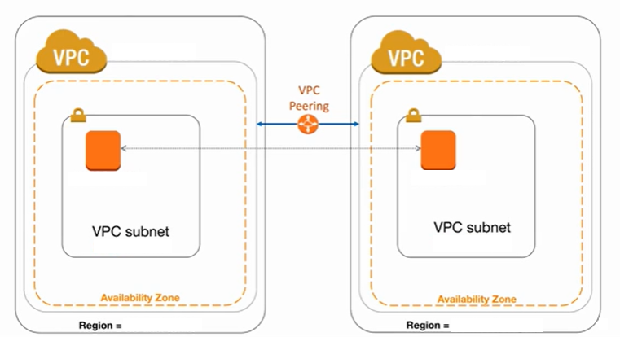
4. VPC Peering between two VPC in different region

Slide 14
Create VPC-Mumbai with CIDR - 10.0.0.0/16
Create Subnet-Mumbai (10.0.0.0/24)
Create Internet Gateway-IGW-Mumbai
Attach IGW-Mumbai to VPC-Mumbai
Create Route Table – Route-Mumbai
Select Route-Mumbai, Edit Route & Add route 0.0.0.0/0, attach with IGW-Mumbai
Select Route-Mumbai, Subnet Association and Select 10.0.0.0/24 & Save
Now repeat above step for VPC-Singapore with CIDR 172.16.0.0/16 & Subnet-172.16.0.0/24
Launch EC2 in both VPC & communicate
Create Peering connection (Mumbai-Singapore), Requester-VPC-Singapore
Select Another Region, Specify Mumbai Region & Enter VPC-Mumbai ID
Go to Mumbai region, peering connection, accept
Now go to Mumbai-Route table, Go to route & add 172.16.0.0/16 with peering connection & vice-versa

Slide 15
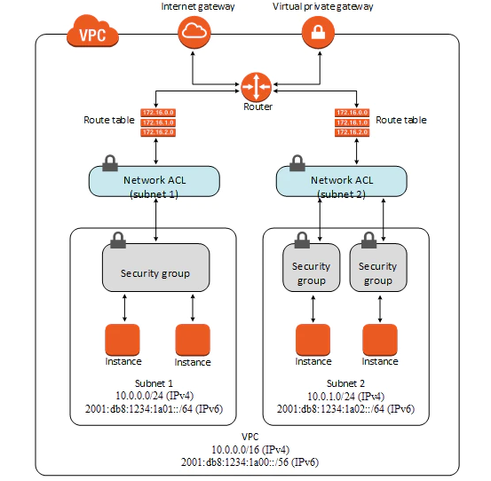
5. AWS NACL inside VPC

Slide 16
Create VPC-01 with CIDR - 10.0.0.0/16
Create Public-Subnet (10.0.0.0/24)
Create Internet Gateway-IGW-01
Attach IGW-01 to VPC-01
Create Route Table – Public-Route
Select Public-Route, Edit Route & Add route 0.0.0.0/0, attach with IGW-01
Select Public-Route, Subnet Association and Select 10.0.0.0/24 & Save
Create Network ACL (Custom-NACL) >Select & associate Public-Subnet with this NACL.
Select Custom-NACL, Allow RDP in Inbound rule, Allow HTTP & HTTPS in Outbound rule
Now launch an EC2 in VPC-01 (Allow All Traffic in Security Group) & try to take RDP
Add New Rule in Outbound Rule inside Custom-NACL, Allow 1024-65535 Ports Now take RDP
Now try to access internet via browser
Add New Rule in Outbound Rule inside Custom-NACL, Allow 1024-65535 Ports & Access Internet

Slide 17
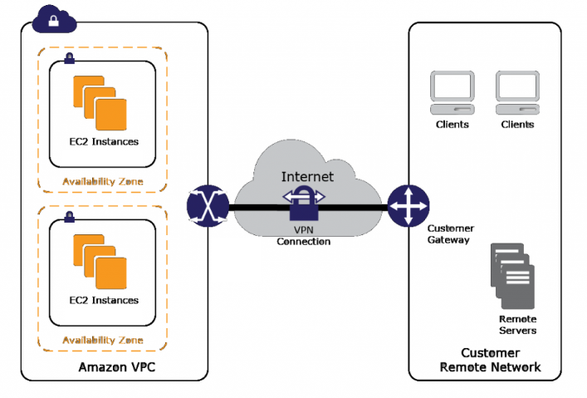
6. VPN connection in AWS

Slide 18
Create VPC-VPN with CIDR - 10.0.0.0/16
Create two Subnet :-
- Public Subnet - 10.0.0.0/24
- Private Subnet - 10.0.1.0/24
Create Internet Gateway-IGW-VPN
Attach IGW-VPN to VPC-VPN
Go to Route Table & Create Two RT
1. Public Route & Add route 0.0.0.0/0 with IGW-NAT And associate public subnet 10.0.0.0/24
2. Private Route - Only associate private subnet 10.0.1.0/24
Now Launch OpenVPN Access Server in Public subnet
Launch EC2 in private subnet
Access OpenVPN through putty ----- login as : openvpnas
Copy Client UI & through browser ---- Username : openvpn
For password go to OpenVPN Machine & Type #sudo passwd openvpn ----- create password

